Slide 1

(mammogram)
Supervised by prof.dR.ahmed said eltrass

Slide 2
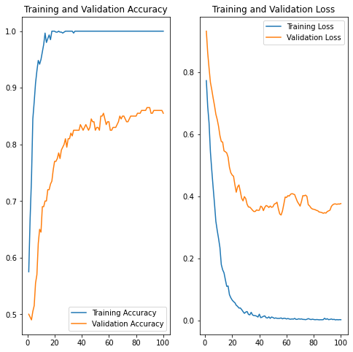
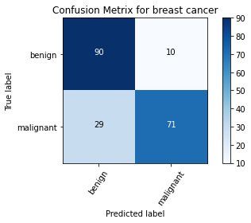
Densenet201
First : 1000 image.
Validation accuracy: 0.865
Test accuracy:0.805

Slide 3
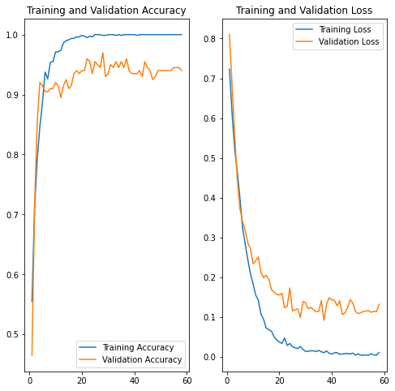
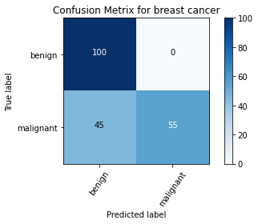
1000 images after augmentation (800image(train))
Validation accuracy: 0.97 , Test accuracy:0.775

Slide 4
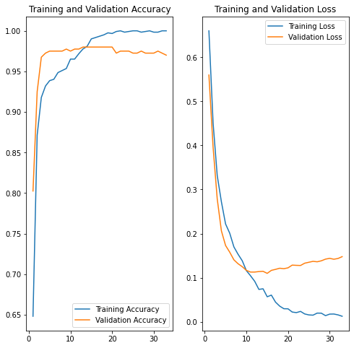
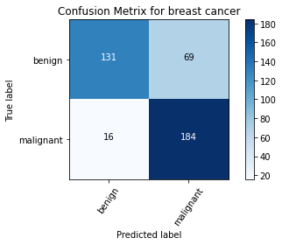
2000 images
Validation accuracy: 0.98 , Test accuracy:0.788

Slide 5
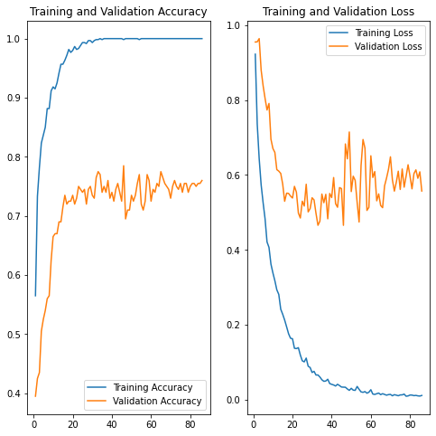
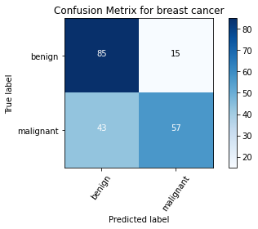
Vgg16
First : 1000 image.
Validation accuracy: 0.785 , Test accuracy: 0.710

Slide 6
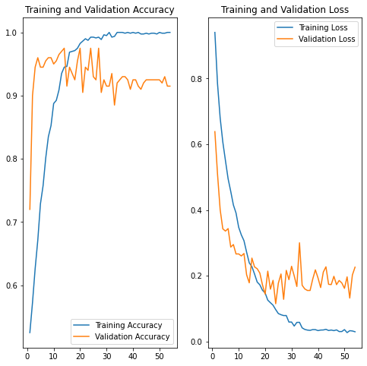
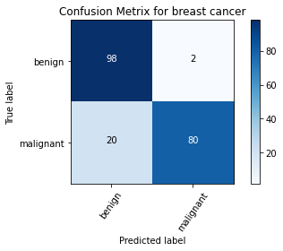
1000 images after augmentation (800image(train))
Validation accuracy: 0.975 , Test accuracy:0.890

Slide 7
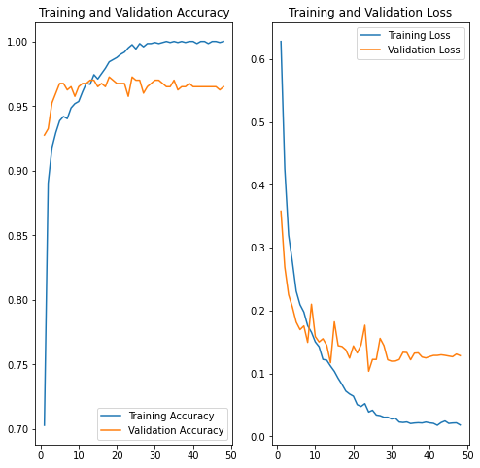

2000 images
Validation accuracy: 0.9725 , Test accuracy:0.805

Slide 8
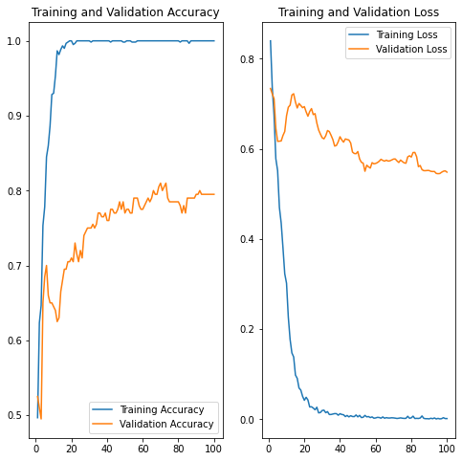
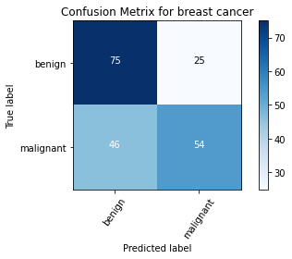
Inception_V3
First : 1000 image.
Validation accuracy: 0.81 , Test accuracy:0.645

Slide 9
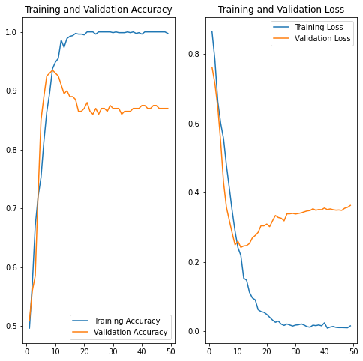

1000 images after augmentation (800image(train))
Validation accuracy: 0.935 , Test accuracy:0.93

Slide 10
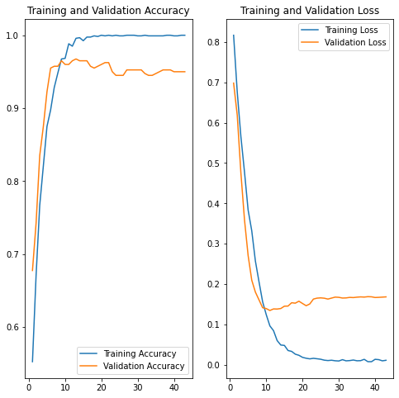
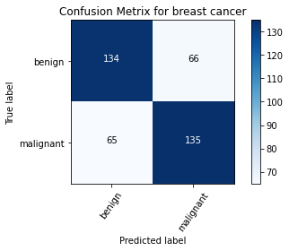
2000 images
Validation accuracy: 0.9675 , Test accuracy:0.672

Slide 11
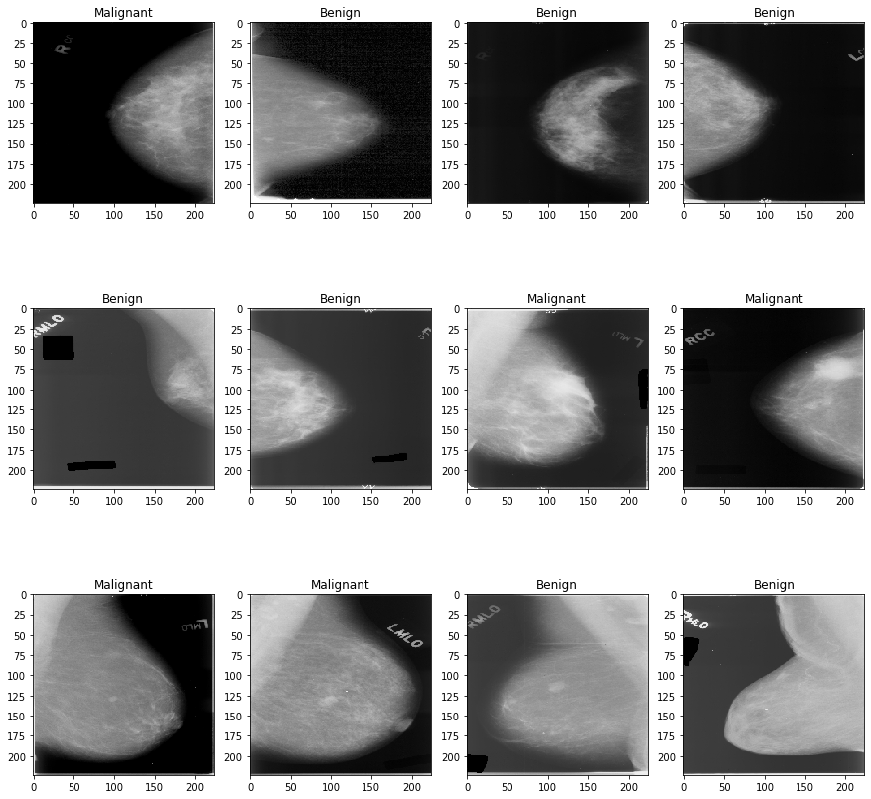
problem

Slide 12
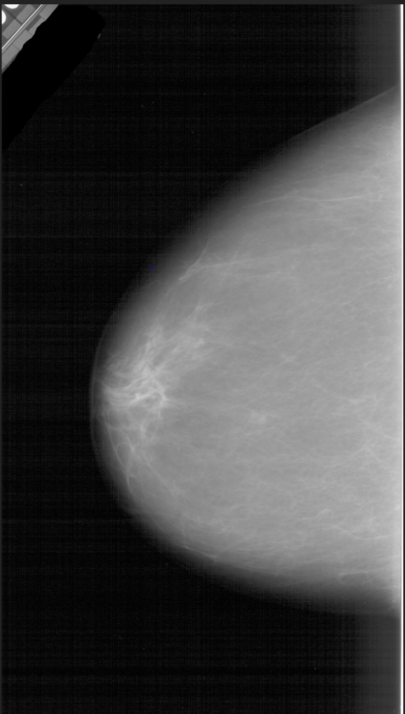
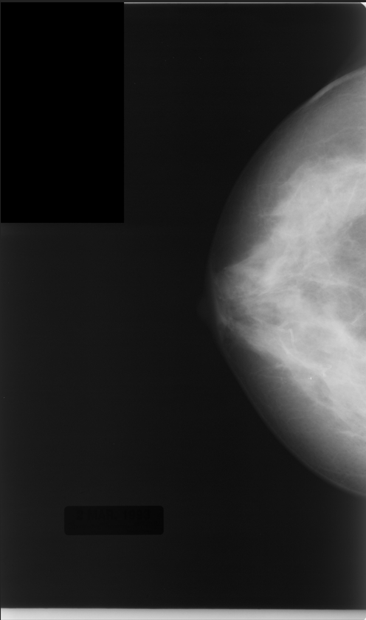
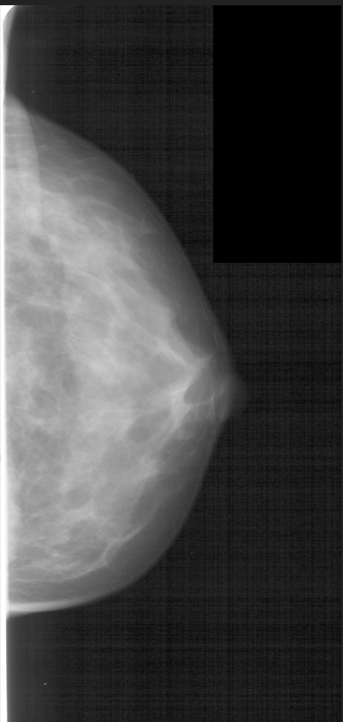
Preprocessing images
First: with black patches

Slide 13
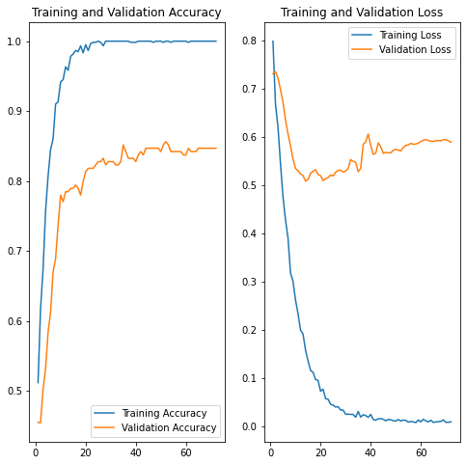
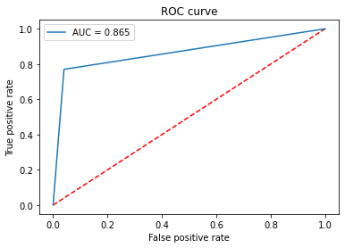

With black batches ( 1000 images) Densenet201
Validation accuracy: 0.8564 , Test accuracy:0.865
Time per image: 0.519453125

Slide 14
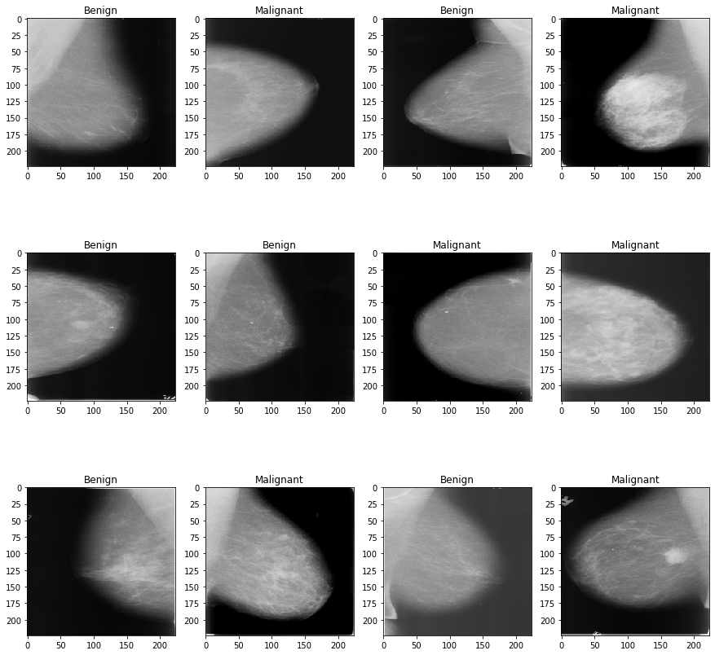
Preprocessing images
Remove labels using code

Slide 15
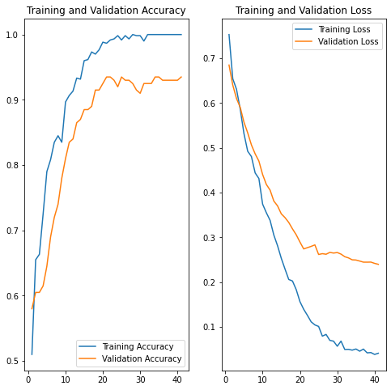

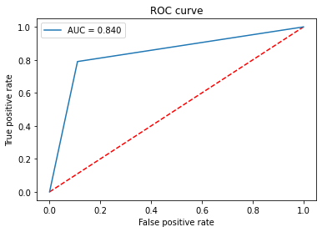
Densenet201
Time per image: 0.459609375

Slide 16
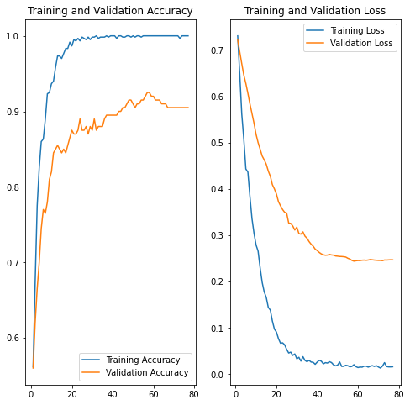
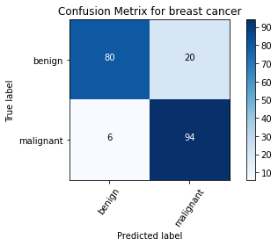
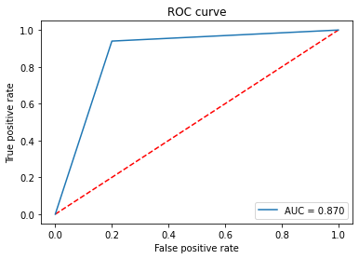
Preprocessing remove labels
(Densenet201)
Validation accuracy: 0.925 , Test accuracy:0.87
After using k fold cross validation average of test accuracy: 0.74
Time per image: 0.51453125

Slide 17
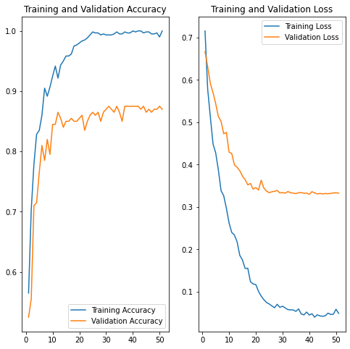

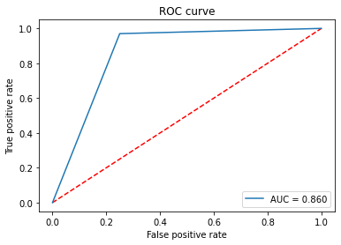
Vgg16
Validation accuracy: 0.875 , Test accuracy:0.860
Time per image: 0.90640625
I

Slide 18
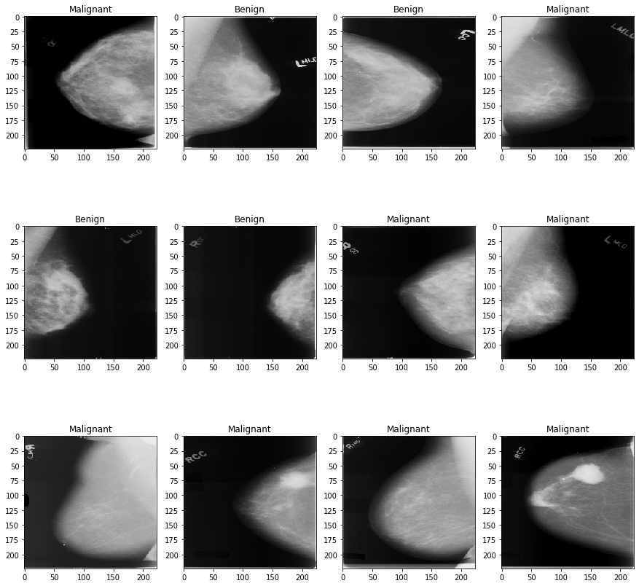
Images after filteration

Slide 19
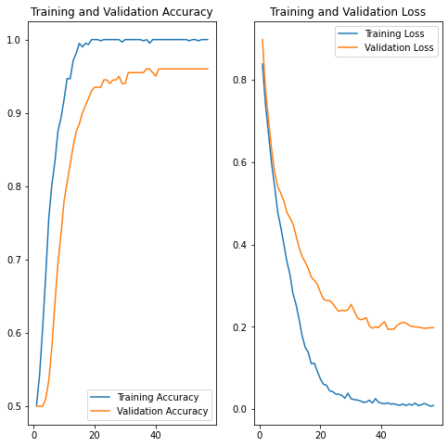
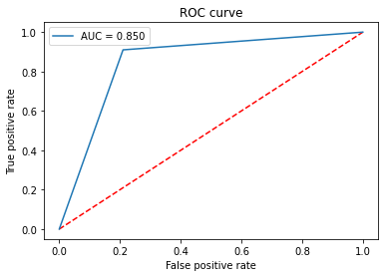

Densenet201(After filteration) 1000 image.
Validation accuracy: 0.96 , Test accuracy:0.85
Test time per image:
After using 5 fold cross validation average of test accuracy: 0.865
0.01060 (GPU)
0.5028 (CPU) GPU is faster by 50 times than CPU
Standard deviation=(+- 1.095444070312461)
Average loss=0.322125, CV=1.2664

Slide 20
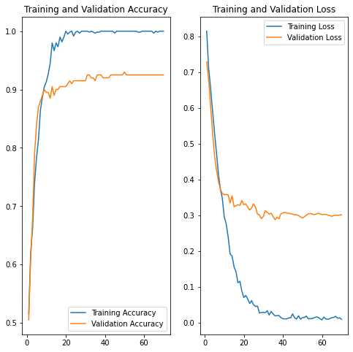
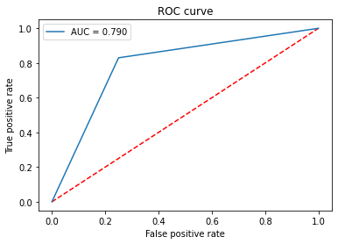

Inception_V3(After filteration) 1000 image.
Validation accuracy: 0.93 , Test accuracy:0.79
Test time per image:
After using 5 fold cross validation average of test accuracy: 0.836
0.00579(GPU)Gpu faster by 60 times
0.33921875(cpu)
Standard deviation=(+-2.922329457890)
Average loss=0.38551853299, CV=3.49560

Slide 21
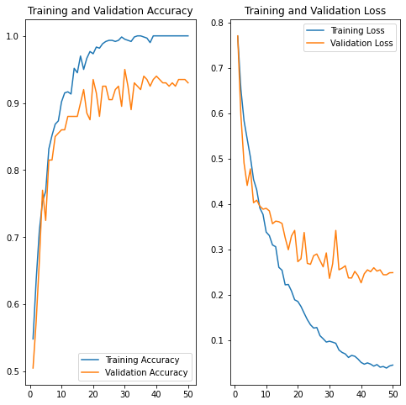


Vgg16(After filteration) 1000 image.
Validation accuracy: 0.95 , Test accuracy:0.82
Test time per image:
0.00977(GPU)
0.65(CPU) GPU is faster by 70 times
After using 5 fold cross validation average of test accuracy: 0.8449
Standard deviation=(+- 2.2583184437657864)
Average loss=0.35830854773521426, CV=2.672

Slide 22
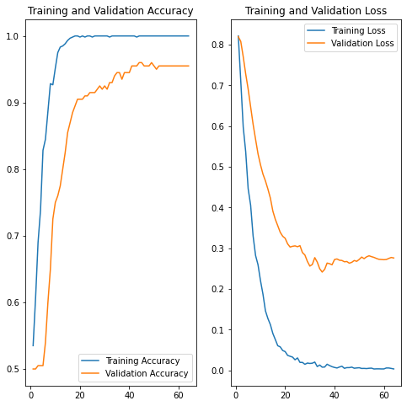
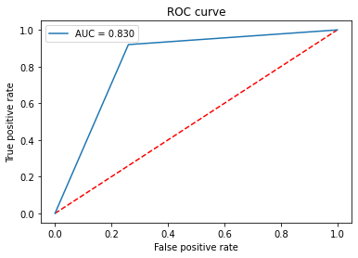

ResNet50(After filteration) 1000 image.
Validation accuracy: 0.96 , Test accuracy:0.83
Test time per image:
0.007054837319999479(GPU)is faster by 40 times
0.258671(CPU)
After using 5 fold cross validation average of test accuracy: 0.800
Standard deviation=(+- 1.7720045738685264)
Average loss=0.47996724843978883, CV=2.215

Slide 23
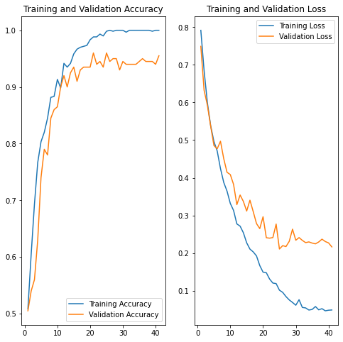
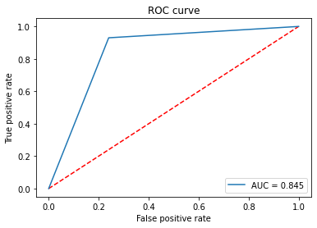

vgg19
Validation accuracy: 0.96 , Test accuracy:0.845
0.011027148530000658(GPU)is faster by 77 times than 0.857(CPU)
Test time per image:
Average scores for all folds:
Accuracy: 85.39999961853027(+- 1.8814897023334223)
Loss: 0.35071900486946106 CV=2.203152

